Slide 1
Learning Python
20220928

Slide 2
Agenda
Learning python
Input and output
Data type

Slide 3
Learning python

Slide 4
What is Python?
Python Jobs
Why to Learn Python?
Python Online Interpreter
one
two
GOOGLE COLAB
YOUR PYTHON CODE

Slide 5
What is Python

Slide 6
Python Jobs

Slide 7
Why to Learn Python

Slide 8
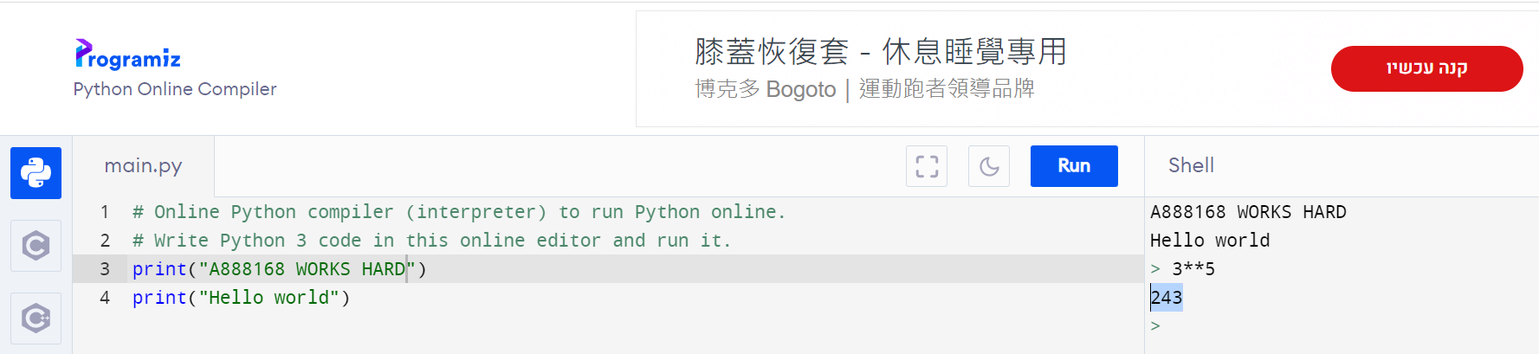
Python Online Interpreter:1
INTERACTIVE

Slide 9
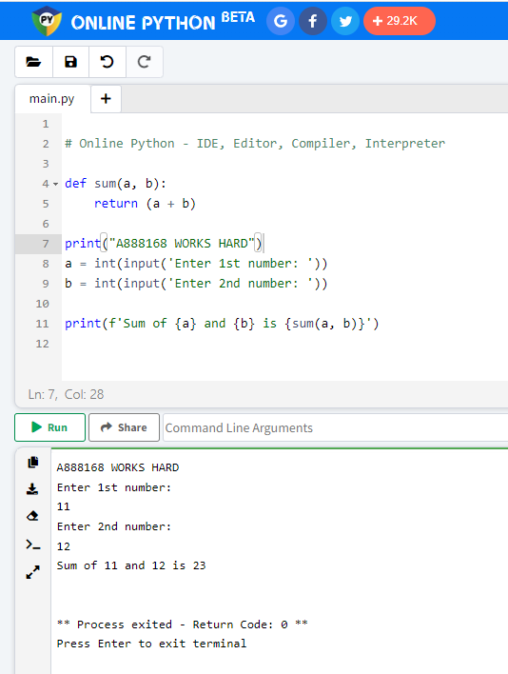
Python Online Interpreter:2

Slide 10
Input and output

Slide 11
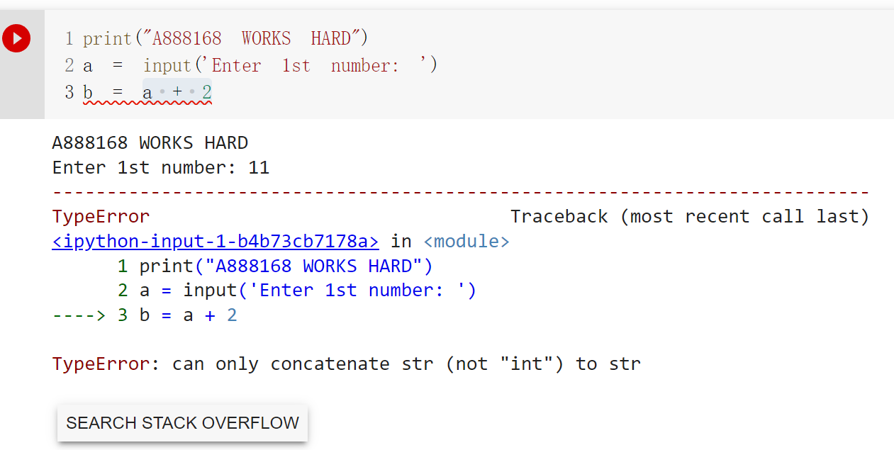
Data type

Slide 12
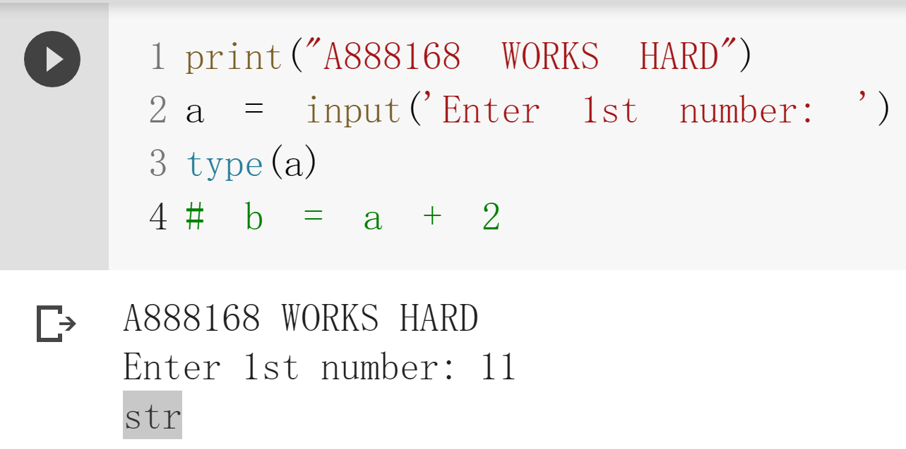

Slide 13
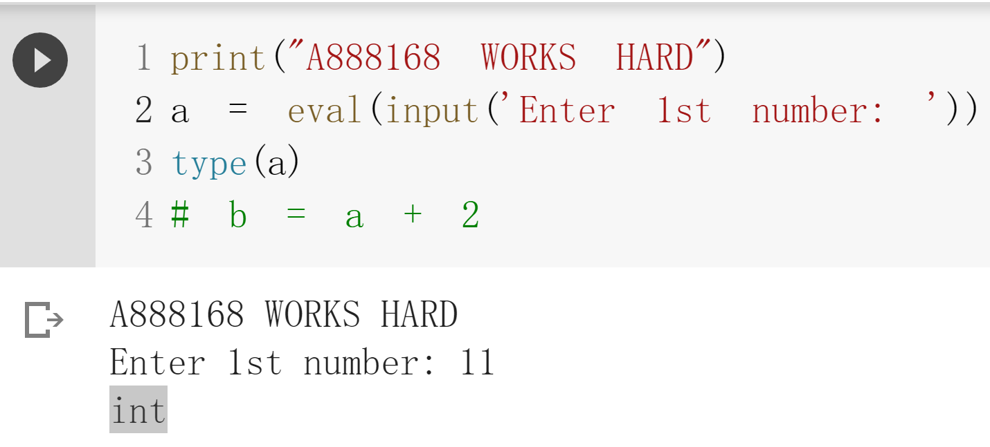

Slide 14
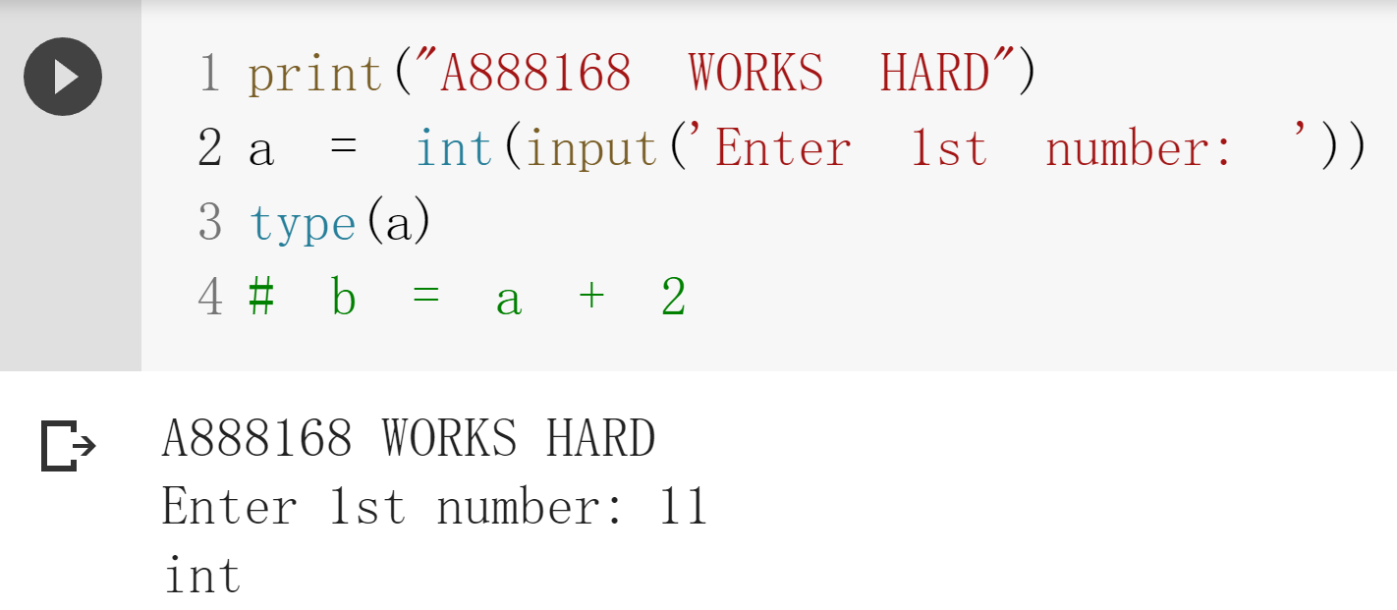

Slide 15
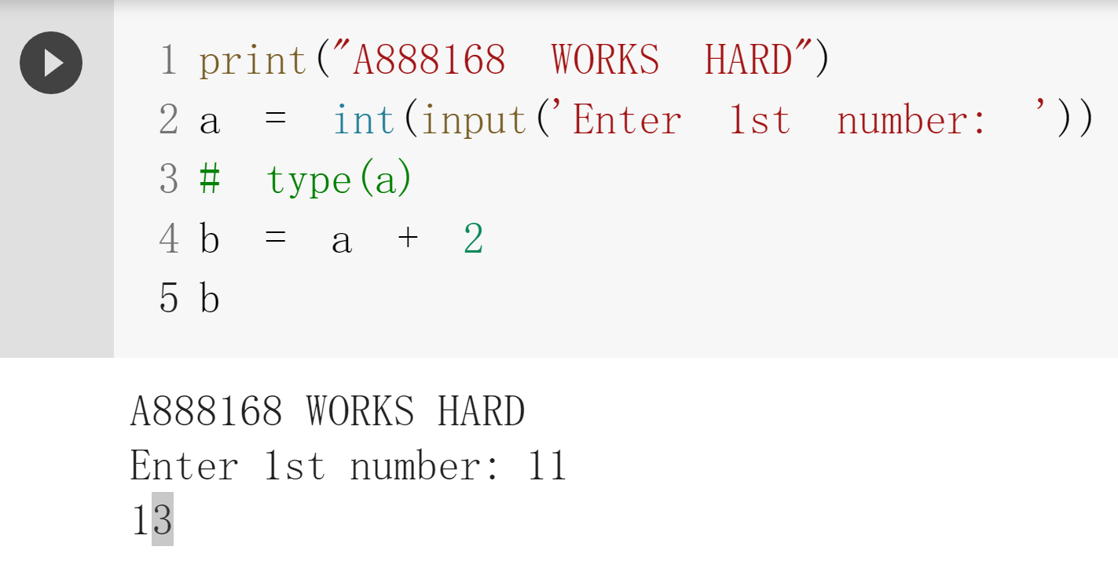

Slide 16
Data type

Slide 17
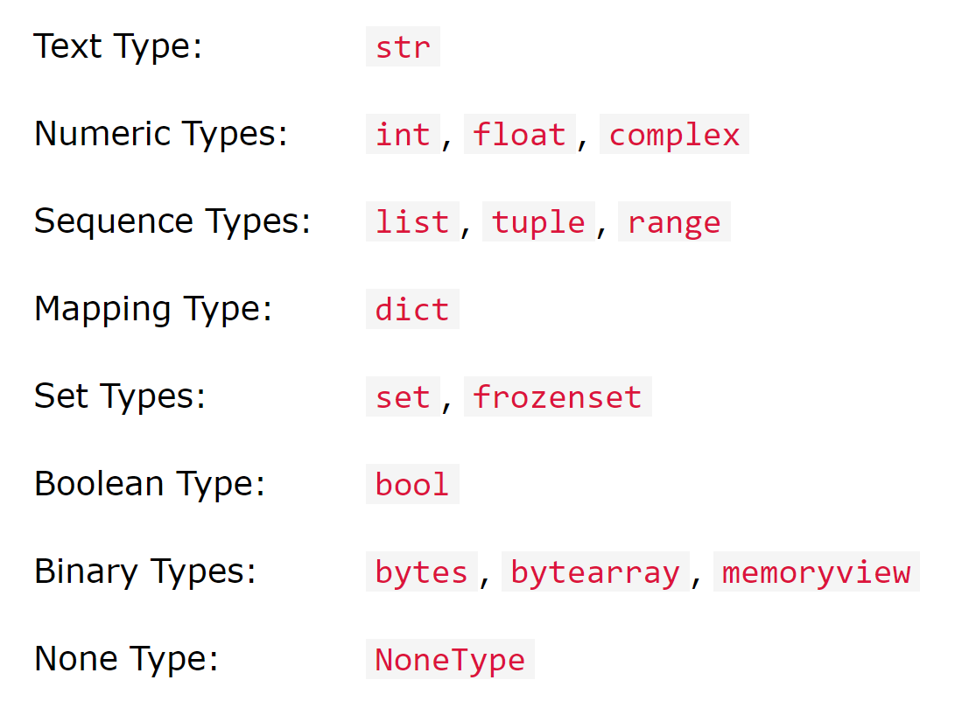
Data type

Slide 18
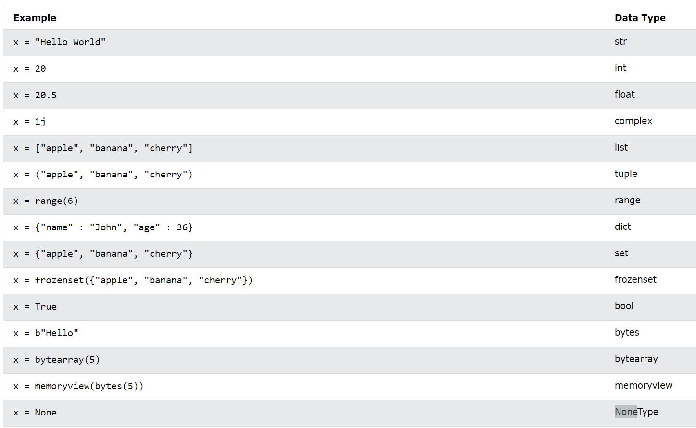

Slide 19
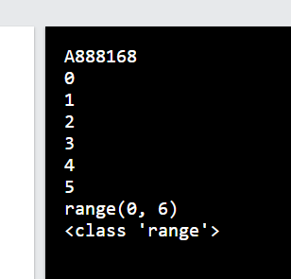
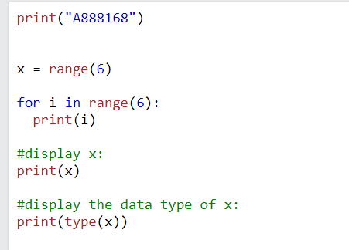

Slide 20
Operator @

Slide 21
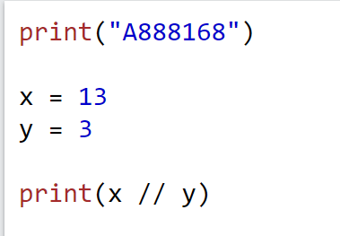
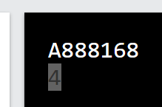
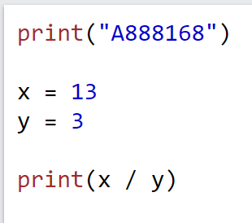
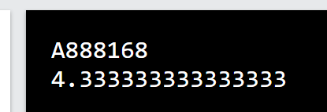

Slide 22
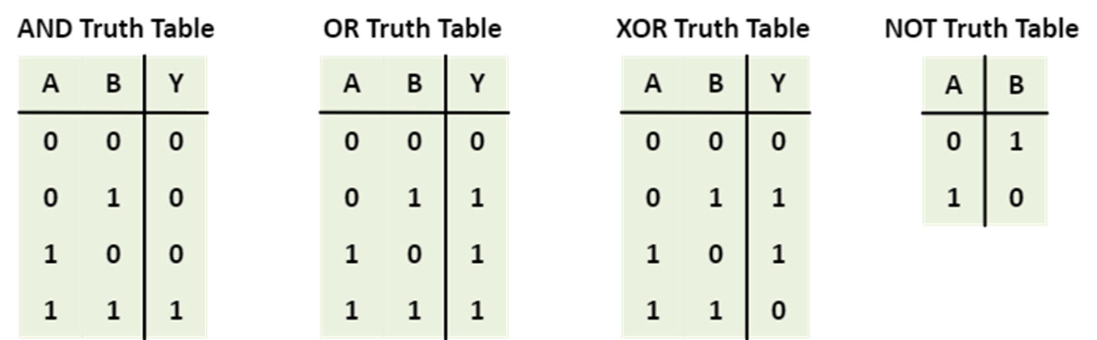
1 == > true 0 == > False

Slide 23
["apple", "banana"]
["apple", "banana"]
z = x
z
x
y
x is y == > False
x == y == > True

Slide 24
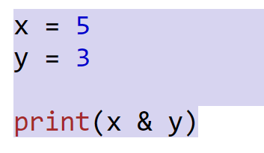
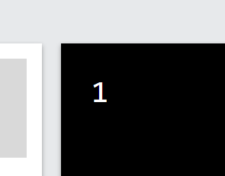
binary
1*2²+0*2¹+1*2⁰
x = 5
y = 3
print(x & y)
(101)₂
(011)₂
(001)₂

Slide 25
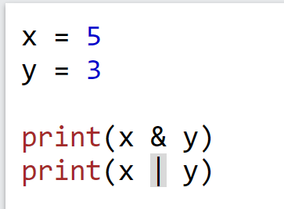
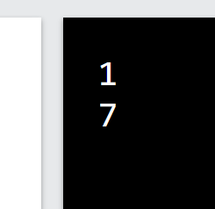
Exercise: how to get a 7 in bitwise-or

